Slide 1

Koob ePub Reader Context-sensitive Lookup Word Sense Disambiguation
CSC 820
By:
Swati Kohli
Poonam Patil

Slide 2
Agenda
Introduction & Background
Project Objective
Related works / Approaches
Project Approaches (Part 1 & 2)
Result & Analysis
Conclusion and Future Scope

Slide 3

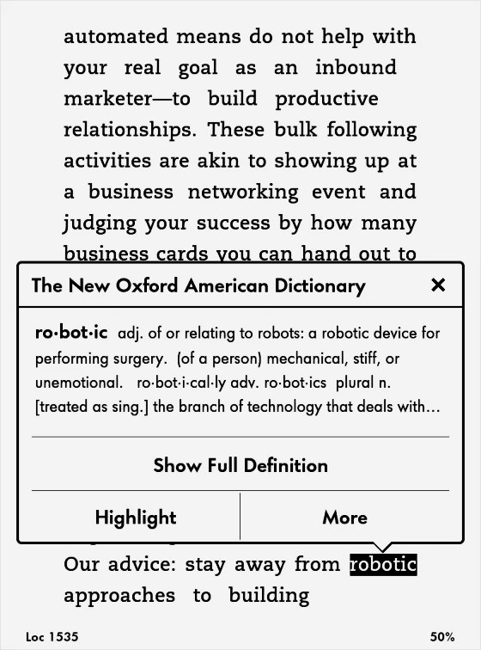
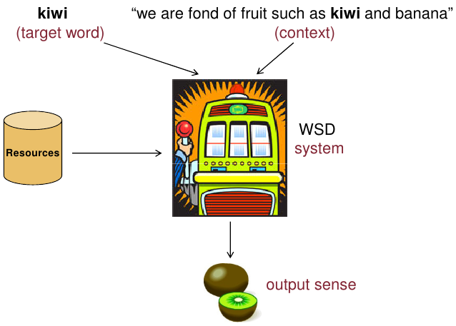
Introduction: WSD
At least 32% ambiguous words
Give richness
Also doubt, especially to ESL
Problem: Existing Apps- Kindle, Apple books, etc.
Provide in-app word lookup
NOT context-sensitive meaning
Solution: Word Sense Disambiguation through NLP
Koob e-Reader
Image Source
Photo by Balázs Kétyi on Unsplash
https://www.liabelle.me/must-know-tips-and-tricks-for-kindle-paperwhite-newbies-part-1/
Notes:
Studies report that At least 32% of the words used in English text are ambiguous and this estimate is considered a lower bound
Words with multiple meanings give English a linguistic richness, but they can also create doubt especially to non native users of English . In this digitized age of e-reading, Although most existing apps such as kindle, and apple books provide an in-app word lookup feature, but they do not provide the context sensitive meaning which becomes a challenge for users with English as second language. This problem is solved by word sense disambiguation which is a technique in NLP to find the exact sense of the ambiguous word in a particular context. WSD is implemented in many areas such as Machine Translation (speech recognition, information extraction and information retrieval. This project is a case in IR and is attributed to Koob e-Reader that is an ebook Application intending to incorporate the solution for the end users. In this image you can see that with WSD techniques, it detects that the target word kiwi is a fruit and not the flightless newzealand bird

Slide 4
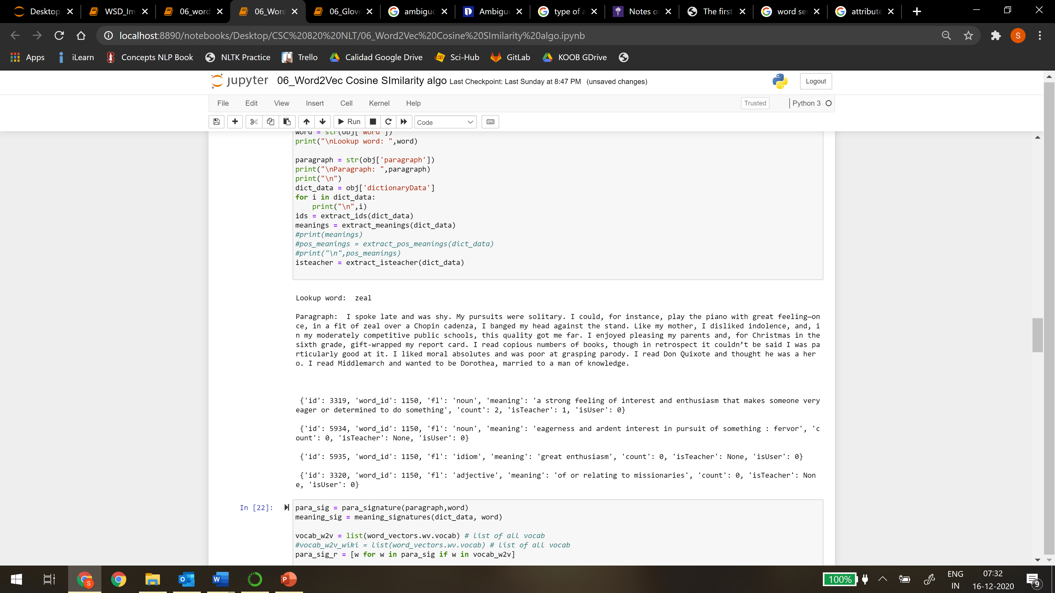
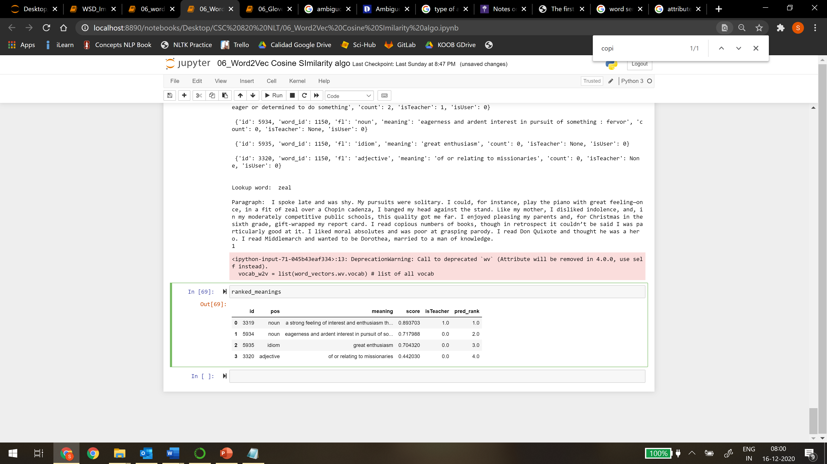
Project Objective & Use Case
Input Data
Explore & Implement Approaches
Output
Ranked Or Best Meaning
Data: 270+ words
Data Source: Book Reading with Patrick
Dictionary Source: Miriam Webster
Metrics: Accuracy & Mean Reciprocal Rank
Look up word: zeal
Look up word: zeal
Ranked Order of Meaning
Word id | id | POS | Meaning | count | isTeacher
1150 | 3319 | noun | a strong feeling of interest and enthusiasm that makes someone very eager or determined to do something | 2 | 1
1150 | 3320 | adjective | of or relating to missionaries | 0 | 0
1150 | 5934 | noun | eagerness and ardent interest in pursuit of something | 0 | 0
1150 | 5935 | idion | great enthusiasm | 0 | 0
Notes:
The project objective is to get the input data from the koob app queries regarding the words and its meanings
research and implement several approaches for wsd and provide the best meaning or a ranked best order of meanings to the looked up word according to the clues provided by the word’s context. We are provided a data of 270+ words taken from the data source of the book for the context as paragraphs and the dictionary source is Miriam webster

Slide 5

Approaches…
Dictionary- and knowledge-based methods: The Lesk method, Semantic Similarity
Supervised methods: Support vector machines and memory-based learning
Semi-supervised or minimally-supervised methods: Use of a secondary source of knowledge (small annotated corpus) as seed data in a bootstrapping process, or a word-aligned bilingual corpus.
Unsupervised methods: K means clustering
Products:
Benedict – The New Intelligent Dictionary (2004)
DEFI Matcher by Michiels (2000)
Notes:
Several approaches and tools have been developed for the purpose

Slide 6
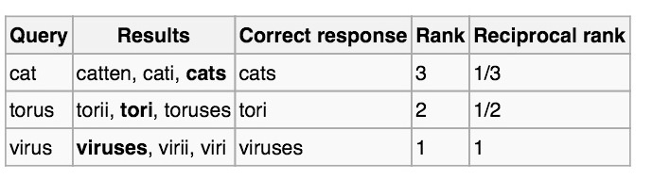
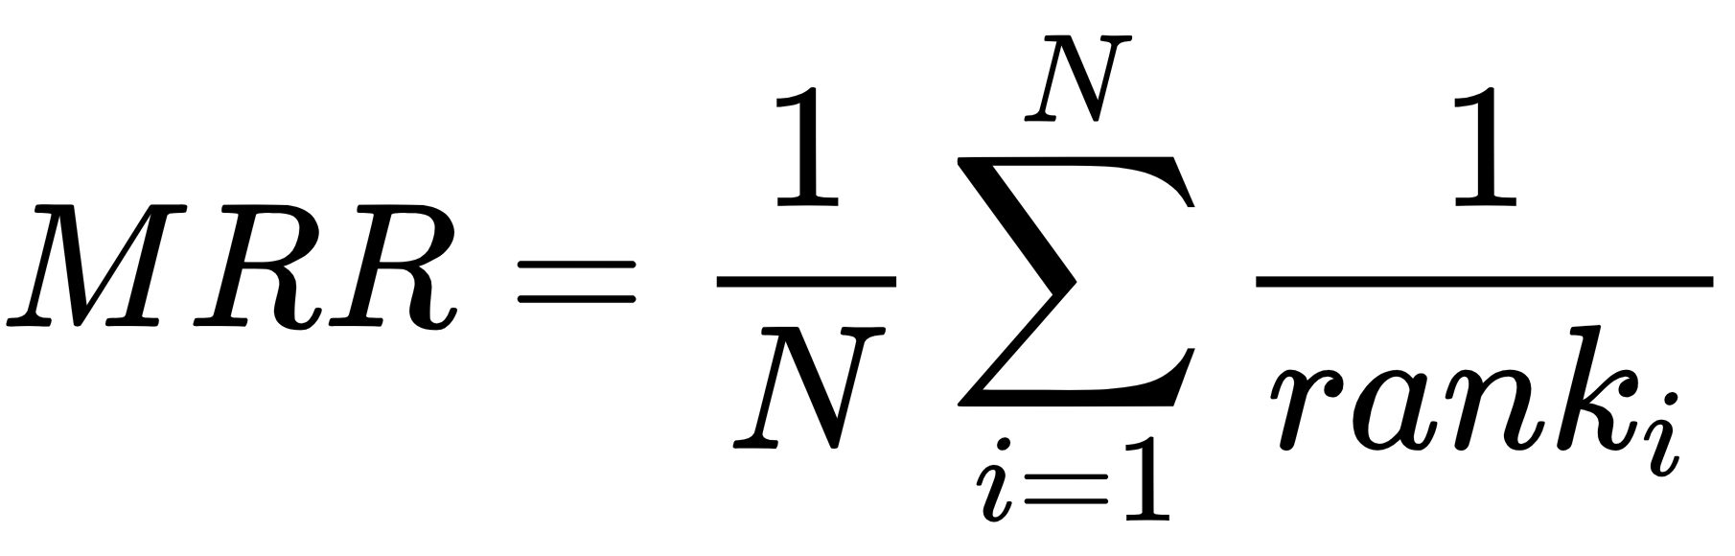
Project Approaches
Baseline
Lesk
Path 1
Context
Similarity
Semantic
Similarity
Path 2
Transfer Learning
Gloss-Bert
Metric:
Accuracy
Mean Reciprocal Rank

Slide 7
Path 1
Input A
Word + Context(Para)
Pre-Processing
Input Bi
Various Dictionary Meanings
Tokenization
Stop words/ Lower Case
Lemmatize/ Stemming
POS tagger
Post Error Analysis Addition
1. Baseline: Lesk
Lesk
Context Similarity- Tfidf
Pretrained Word Embeddings
Word2Vec, GloVe, FastText
2. Tf-Idf
Measure:
Context Overlap- CosineSim
Measure: Cosine Sim, Euclidean, Manhattan
Measure: Cosine Similarity, Soft Cosine Similarity
3. Semantic Similarity Pretrained Word Embeddings
Metric:
Accuracy, MRR
Output:
Ranked Meanings
Notes:
Tfidf is based on the importance of words both inputs commonly share ie the frequency of occurrence of shared words (between A and Bi). A and each Bi are mapped as a point in a multi-dimensional space where the number of dimensions is equal to the number of unique words. Similarity or distance are taken as measures to evaluate the overlap.
Semantic Similarity is a more advanced approach to compare A and Bi based on how similar the words are. To do this, 3 pre trained word embeddings were employed that are Word2Vec, GloVe and FastText to embed or map the words into a numerical vectors where the words that occur together more often are spaced closer to each other in space.

Slide 8
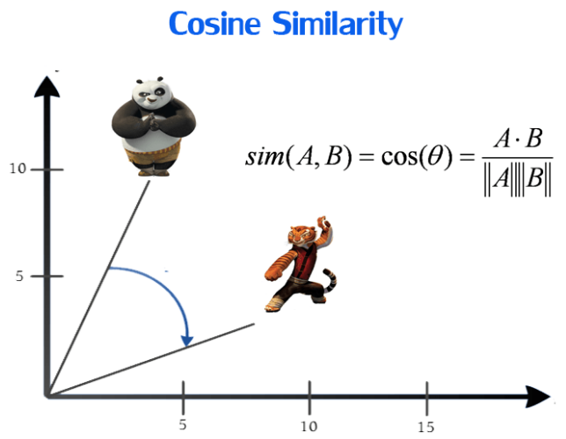
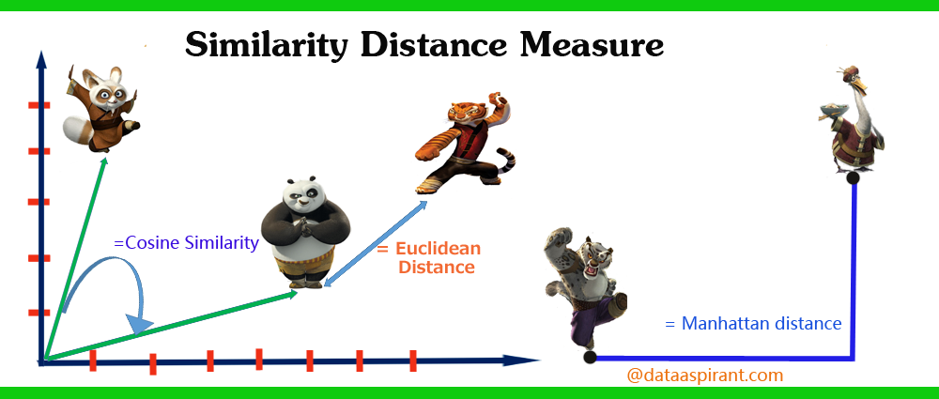
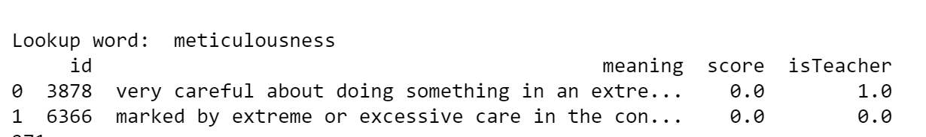
Path 1
Input A
Word + Context(Para)
Pre-Processing
Input Bi
Various Dictionary Meanings
2. Tf-Idf
Based on the frequency of occurrence of shared words btw A & Bi
Requires pre-processed words -> lemmatization, stemming vital
Simple & Fast
Metrics:
Cosine Similarity
Euclidean Distance
Manhattan Distance
Context Similarity- Tfidf
Measure: Cosine Sim, Euclidean, Manhattan
Metric:
Accuracy, MRR
Output:
Ranked Meanings
Result Analysis: Add another condition
Notes:
Tfidf is based on the importance of words both inputs commonly share ie the frequency of occurrence of shared words (between A and Bi). A and each Bi are mapped as a point in a multi-dimensional space where the number of dimensions is equal to the number of unique words. Similarity or distance are taken as measures to evaluate the overlap. If

Slide 9
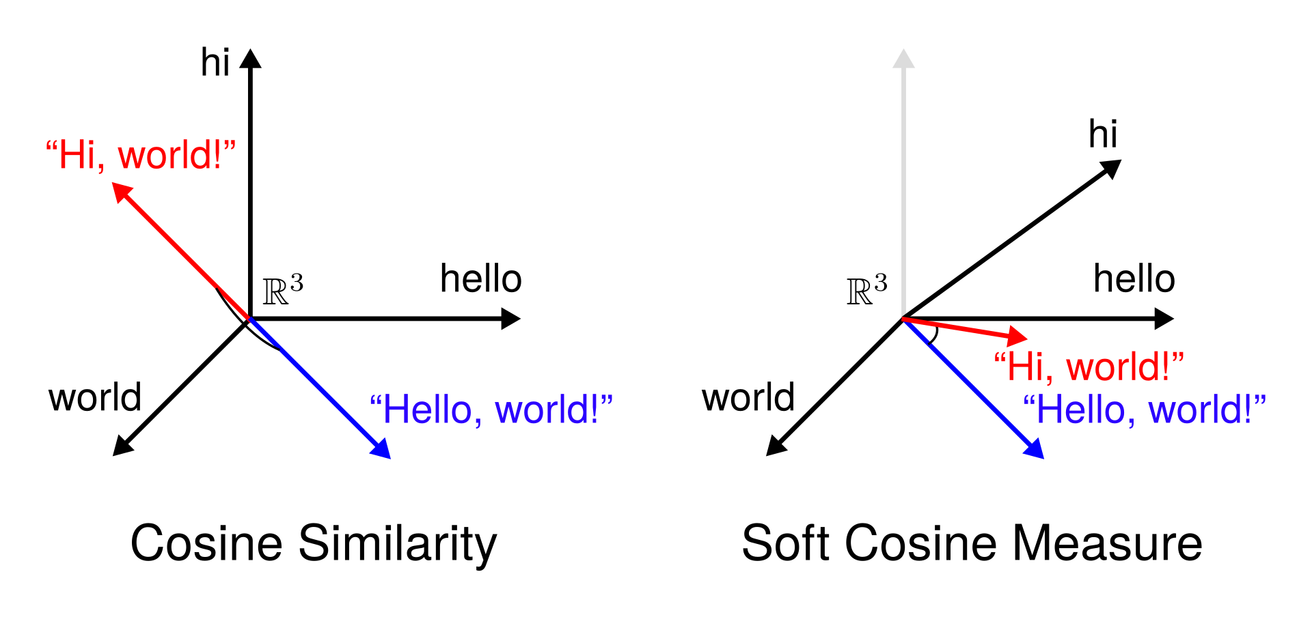



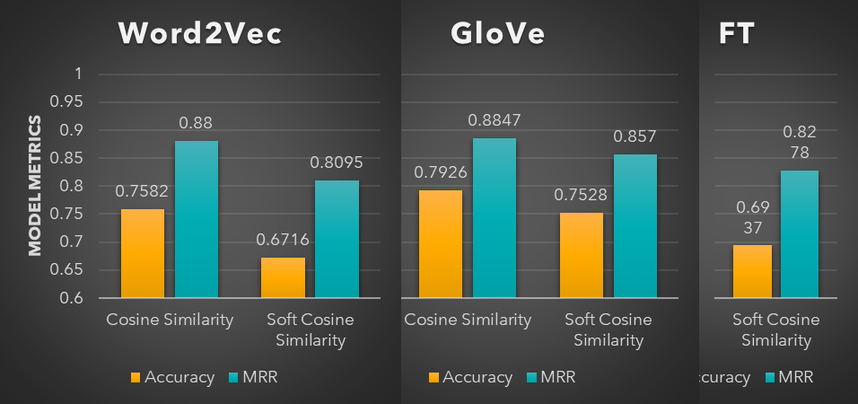
Path 1
Input A
Word + Context(Para)
Pre-Processing
Input Bi
Various Dictionary Meanings
3. Semantic Similarity
Based on shared words having similar concepts
Requires a word embedding model:
Word2Vec
GloVe
FastText
Good with low word overlap as does not require exact match
Metrics:
Cosine Similarity – feature independence
Soft Cosine Similarity – feature similarity
Context Similarity- Tfidf
Similarity Matrix (Similarity Index A, Bi, TfIdf)
Metric:
Accuracy, MRR
Output:
Ranked Meanings
Notes:
Semantic Similarity is a more advanced approach to compare A and Bi based on how similar the words are. To do this, 3 pre trained word embeddings were employed that are Word2Vec, GloVe and FastText to embed or map the words into a numerical vectors where the words that occur together more often are spaced closer to each other in space.
So we saw cosine similarity and another metric was used as soft that measures between A and each of Bi (unlike cosine similarity which returns 0 for vectors with no overlapping terms). The soft cosine similarity considers word similarity as well.
The difference is that cosine similarity considers the vector space model (VSM) features as independent or completely different, while the soft cosine measure considers the similarity of features in VSM,
So through these word embeddings, it maps the word into numerical vector where words that occur together more often are near each other in space. And then a similarity matrix is created containing similarity between each pair of words that is weighted using term frequency. On this finally the soft cosine similarity is calculated

Slide 10

Results & Analysis
Word embeddings give a higher score comparatively
Pre-trained word embeddings with GloVe shows best performance overall in both metrics.
Tf-Idf performance can be explored further by applying more pre-processing techniques and more data/error analysis

Slide 11

WSD using Transfer Learning : BERT

Slide 12
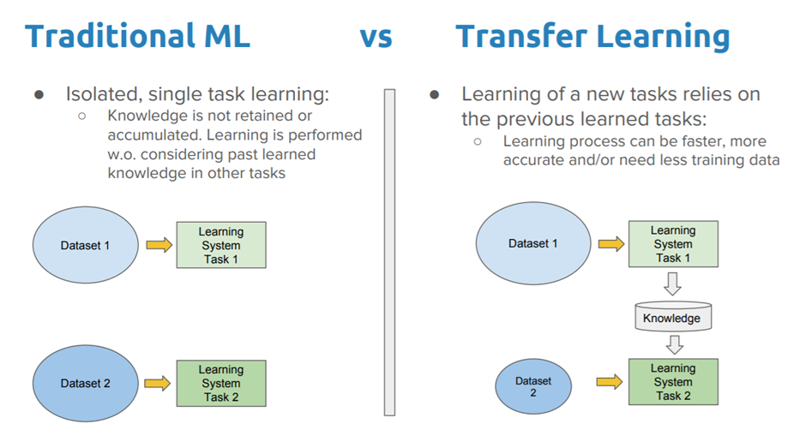
Traditional ML Vs Transfer Learning
Notes:
The traditional machine learning techniques try to learn each task from scratch, while transfer learning techniques try to transfer the knowledge from some previous tasks to a target task.

Slide 13

What is BERT?
Bidirectional Encoder Representations from Transformers (BERT)
BERT is a method of pre-training language representations.
First unsupervised, deeply bidirectional system for pre-training NLP
Notes:
BERT is a method of pre-training language representations, meaning that it is a general-purpose "language understanding" model trained on a large text corpus, and then use that model for downstream NLP tasks that we care about (like question answering). BERT outperforms previous methods because it is the first unsupervised, deeply bidirectional system for pre-training NLP. Unsupervised means that BERT was trained using only a plain text corpus

Slide 14
Context-free Vs Contextual models
Context-free models
Word2vec
GloVe
Same representation for ‘bank’ in ‘bank deposit’ and ‘river bank’.
Contextual models
BERT
Generate a representation of each word based on the other words in sentence
Notes:
Context-free models such as word2vec or GloVe generate a single "word embedding" representation for each word in the vocabulary

Slide 15
Contextual models
Other contextual representation model are - semi-supervised sequence learning, generative pre-training, ELMo and ULMFit
These models are unidirectional or bidirectional.
In ‘I made a bank deposit’, representation of ‘bank’ is only based on ‘I made a’ and but not ‘deposit’.
BERT represents ‘Bank’ using both it’s left and right context starting from a very bottom of deep neural network, therefore it is deeply bidirectional.
Notes:
BERT looks at the content before and after a word to inform its understanding of the meaning and relevance of that word. “This is a critical enhancement in natural language processing as human communication is naturally layered and complex.”

Slide 16
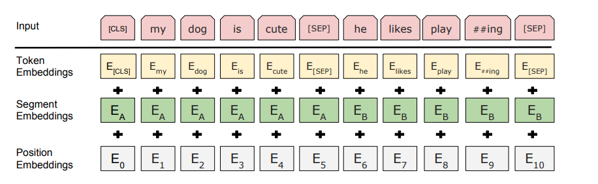
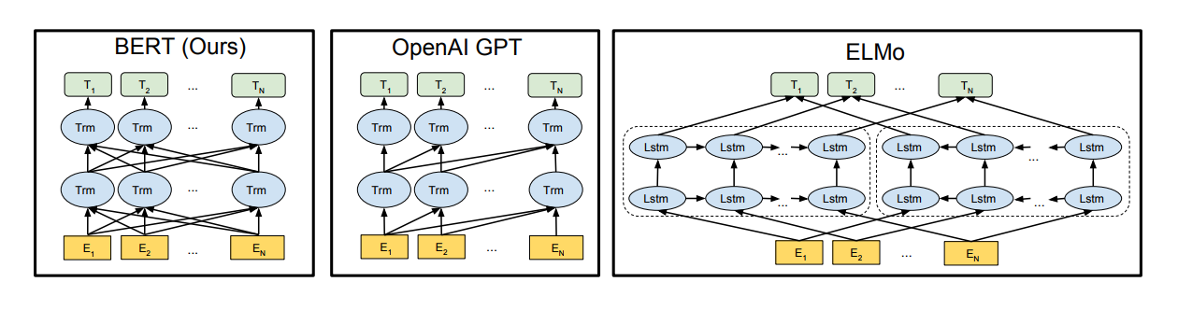
BERT Input Representation and Architecture
BERT input representation
Image source
BERT is deeply bidirectional, OpenAI GPT is unidirectional, and ELMo is shallowly bidirectional
Image source
Notes:
Here in the BERT input representation, the input embeddings are the sum of the token embeddings, the segmentation embeddings and the position embeddings.
In Bert architecture we can see that every token attend to every other token in the self attention layer
Whereas, in OpenAI GPT (Generative Pre-trained Transformer), it uses a left-to right architecture, where every token can only attend to previous tokens in the self-attention layers of the Transformer. ELMo architecture learns contextual representations single word from both left and right context using LSTMs.

Slide 17
BERT Implementation Approach
2 step framework
Pre-training: Trained on large unlabeled text corpus (2,500M Wikipedia + 800M book corpus)
Tasks:
Masked language model
Next sentence prediction
Fine-tuning: Pre-trained parameters are fine-tuned using labeled data from downstream task
Notes:
Bert model implementation is a two step framework.
In the first step, BERT model is trained on text corpus of about 2,500 million words from Wikipedia + 800M words from books,.
The training process involves two tasks, masked language model and next sentence prediction. The masked language model randomly masks some of the tokens from the input (around 15%), and the objective is to predict the original vocabulary id of the masked word based only on its context. In addition to the masked language model, the “next sentence prediction” task jointly pretrains text-pair representations.
Now that we got language representation using BERT, second step is fine-tuning. For finetuning, the BERT model is first initialized with the pre-trained parameters, and all the parameters are fine-tuned using labeled data from the downstream tasks. Downstream tasks can include question answering, next sentence prediction, or word sense disambiguation.
Now that we know enough about BERT model and how to find tune it, Let’s go back to out task of word sense disambiguation (WSD).

Slide 18
Sample Input Json
{'word': 'from scratch’,
'sentence': 'I steeled myself. ‘,
'paragraph': 'I steeled myself. I would start from scratch. I would root out like weeds the effects of my parents, the tendency to choose safe options, to get ahead, to feel secure. I would embrace irrational measures. In college I worked at a homeless shelter, where I slept overnight on Fridays and signed up for extra shifts precisely when I had papers due. I dropped pre-med and majored in social studies and gender studies. I edited a small magazine about race and class and sexuality. And when I met other Asian Americans, those bound for consultant and hedge-fund jobs where they would make six figures, my judgment was harsh. Silently, through my narrowed eyes, I told them, I know you, and there’s not too much to know.’,
'dictionaryData': [{'id': 5926,
'word_id': 1999,
'fl': 'idiom’,
'meaning': 'to begin from a point at which nothing has been done yet’,
'count': 1,
'isTeacher': 1,
'isUser': 1},
{'id': 5925,
'word_id': 1999,
'fl': 'noun’,
'meaning': 'a mark or injury produced by scratching; also : a slight wound’,
'count': 0,
'isTeacher': None,
'isUser': 0}]}
Notes:
We got a sample json file with 272 target words where senses are manually voted by Teacher. But this data is not enough to train BERT for the word sense disambiguation task. Therefore, we decided to use some other model which uses BERT training parameters for language representation and finetuned with other data corpus for WSD task therefore selected GlossBERT model checkpoint for the WSD task.

Slide 19
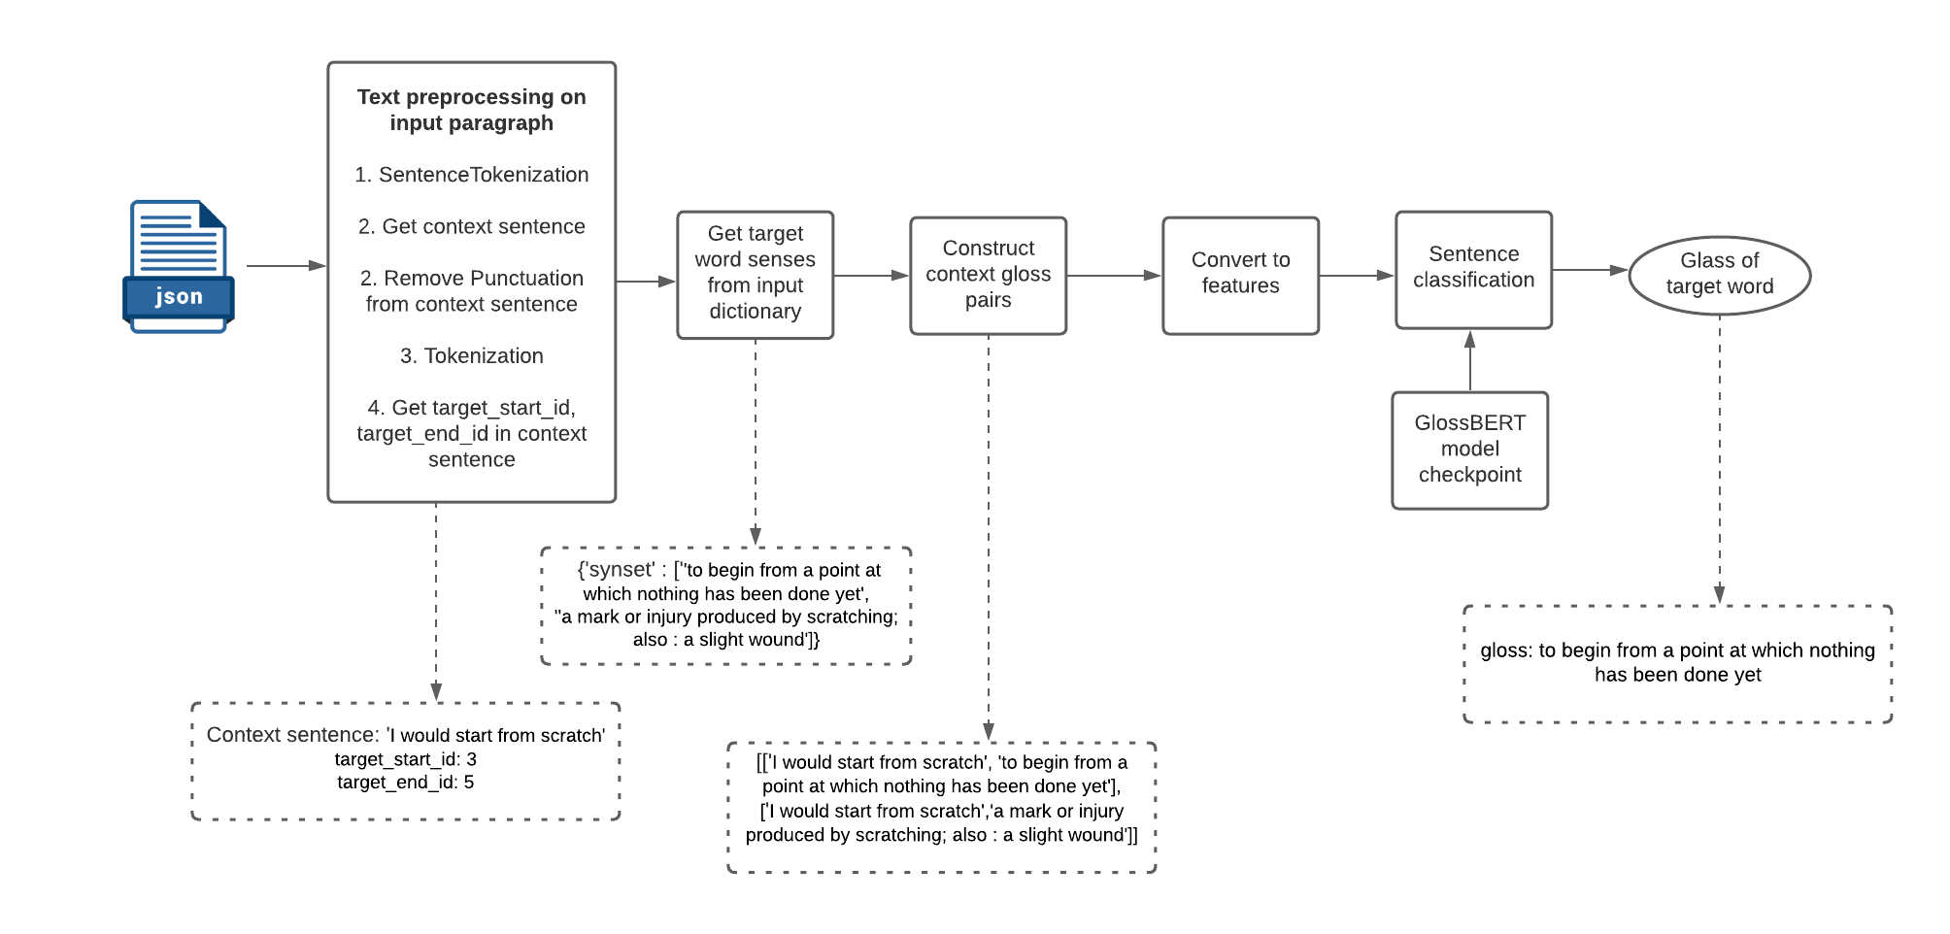
Our WSD Approach
GlossBERT model (checkpoint) by Luyao et. al (2019) fine-tuned on SemCor3.0 training corpus
Notes:
A SemCor corpus is a sense-tagged corpora created by a WordNet Project research team at Princeton University.
It can (typically) be a subset of the English Brown Corpus containing 360,000 words

Slide 20
Evaluation
WSD Model | Accuracy
Baseline: Lesk algorithm with cosine similarity as distance measure | 49%
WSD with GlossBERT | 70.58%
JSON Input:
{'word': 'bludgeoned’,
'dictionaryData': [{'id': 1080,
'meaning': 'to hit (someone or something) very hard’,
'isTeacher’: 1},
{'id': 5697,
'meaning': 'to hit with heavy impact’,
'isTeacher': None}
GlossBERT Output:
'word': 'bludgeoned’,
gloss: to hit with heavy impact

Slide 21
Conclusion and Future Scope
Conclusion: Accuracy for Word sense disambiguation is pretty good (70.58%) for a transfer learning model using BERT embeddings
Cons of BERT model: GlossBERT model is a heavy weight model
Future Scope
Study input data in greater depth
Find balance btw higher performance vs Computational complexity

Slide 22


Slide 23


Slide 24
References
http://www.scholarpedia.org/article/Word_sense_disambiguation#Dictionary-_and_knowledge-based_methods
https://www.linkedin.com/pulse/wordnet-word-sense-disambiguation-wsd-nltk-aswathi-nambiar
https://www.lexalytics.com/lexablog/context-analysis-nlp
https://towardsdatascience.com/representing-text-in-natural-language-processing-1eead30e57d8
https://medium.com/swlh/semantic-search-with-nlp-86084ca81247
https://github.com/RaRe-Technologies/gensim/blob/develop/docs/notebooks/soft_cosine_tutorial.ipynb
https://arxiv.org/pdf/1908.07245.pdf
https://docs.google.com/presentation/d/1fIhGikFPnb7G5kr58OvYC3GN4io7MznnM0aAgadvJfc/edit#slide=id.g5888218f39_50_673
https://github.com/google-research/bert

